Slide 1
Primary Entrance
Youth & Wheelchair
Entrance
Formal Entrance
Office Entrance
PROPOSED SITE PLAN
AF 14 427 SHCR
Smoky Lake, Alberta

Slide 2
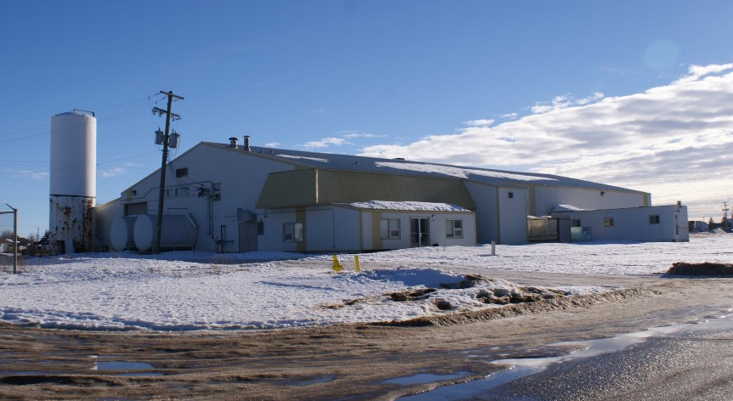
EXTERIOR 1
AF 14 427 SHCR
Smoky Lake, Alberta

Slide 3
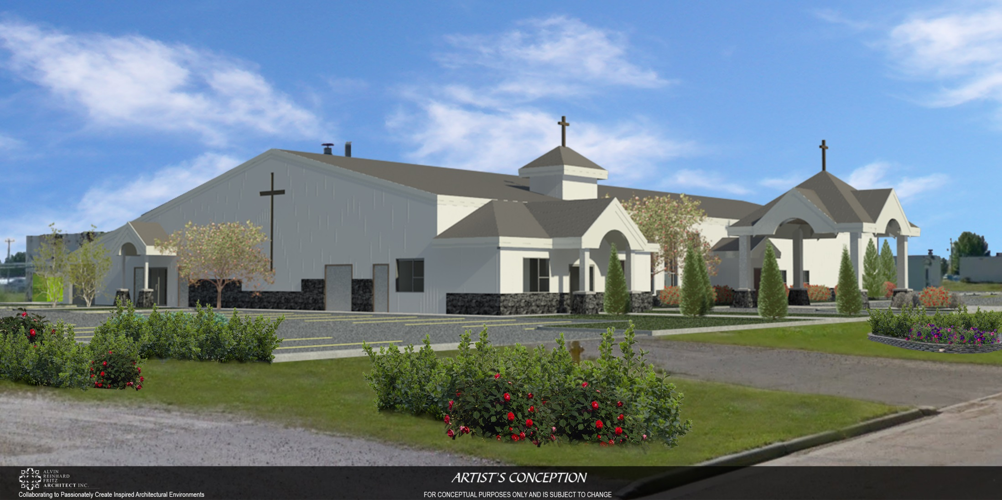
CONCEPTUAL BUILDING ON SITE
AF 14 427 SHCR
Smoky Lake, Alberta

Slide 4
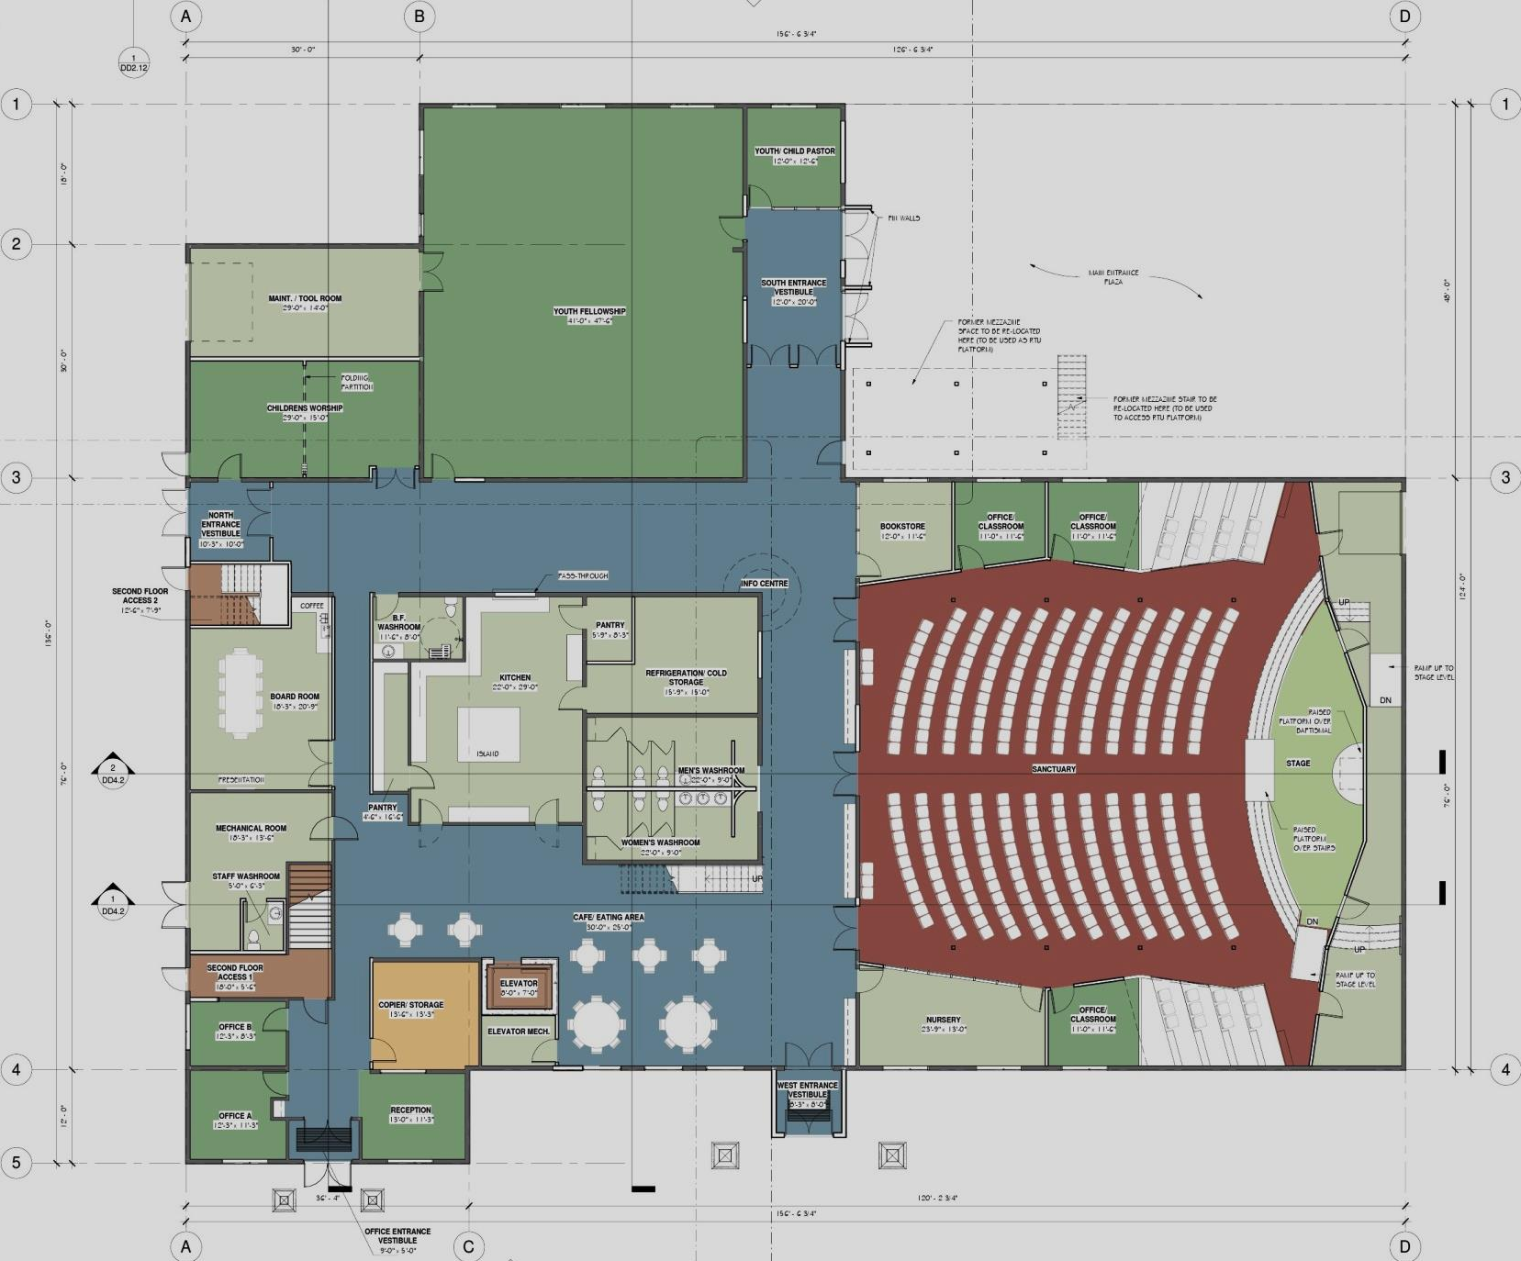
PROPOSED MAIN FLOOR PLAN
(COLOURED)
AF 14 427 SHCR
Smoky Lake, Alberta

Slide 5
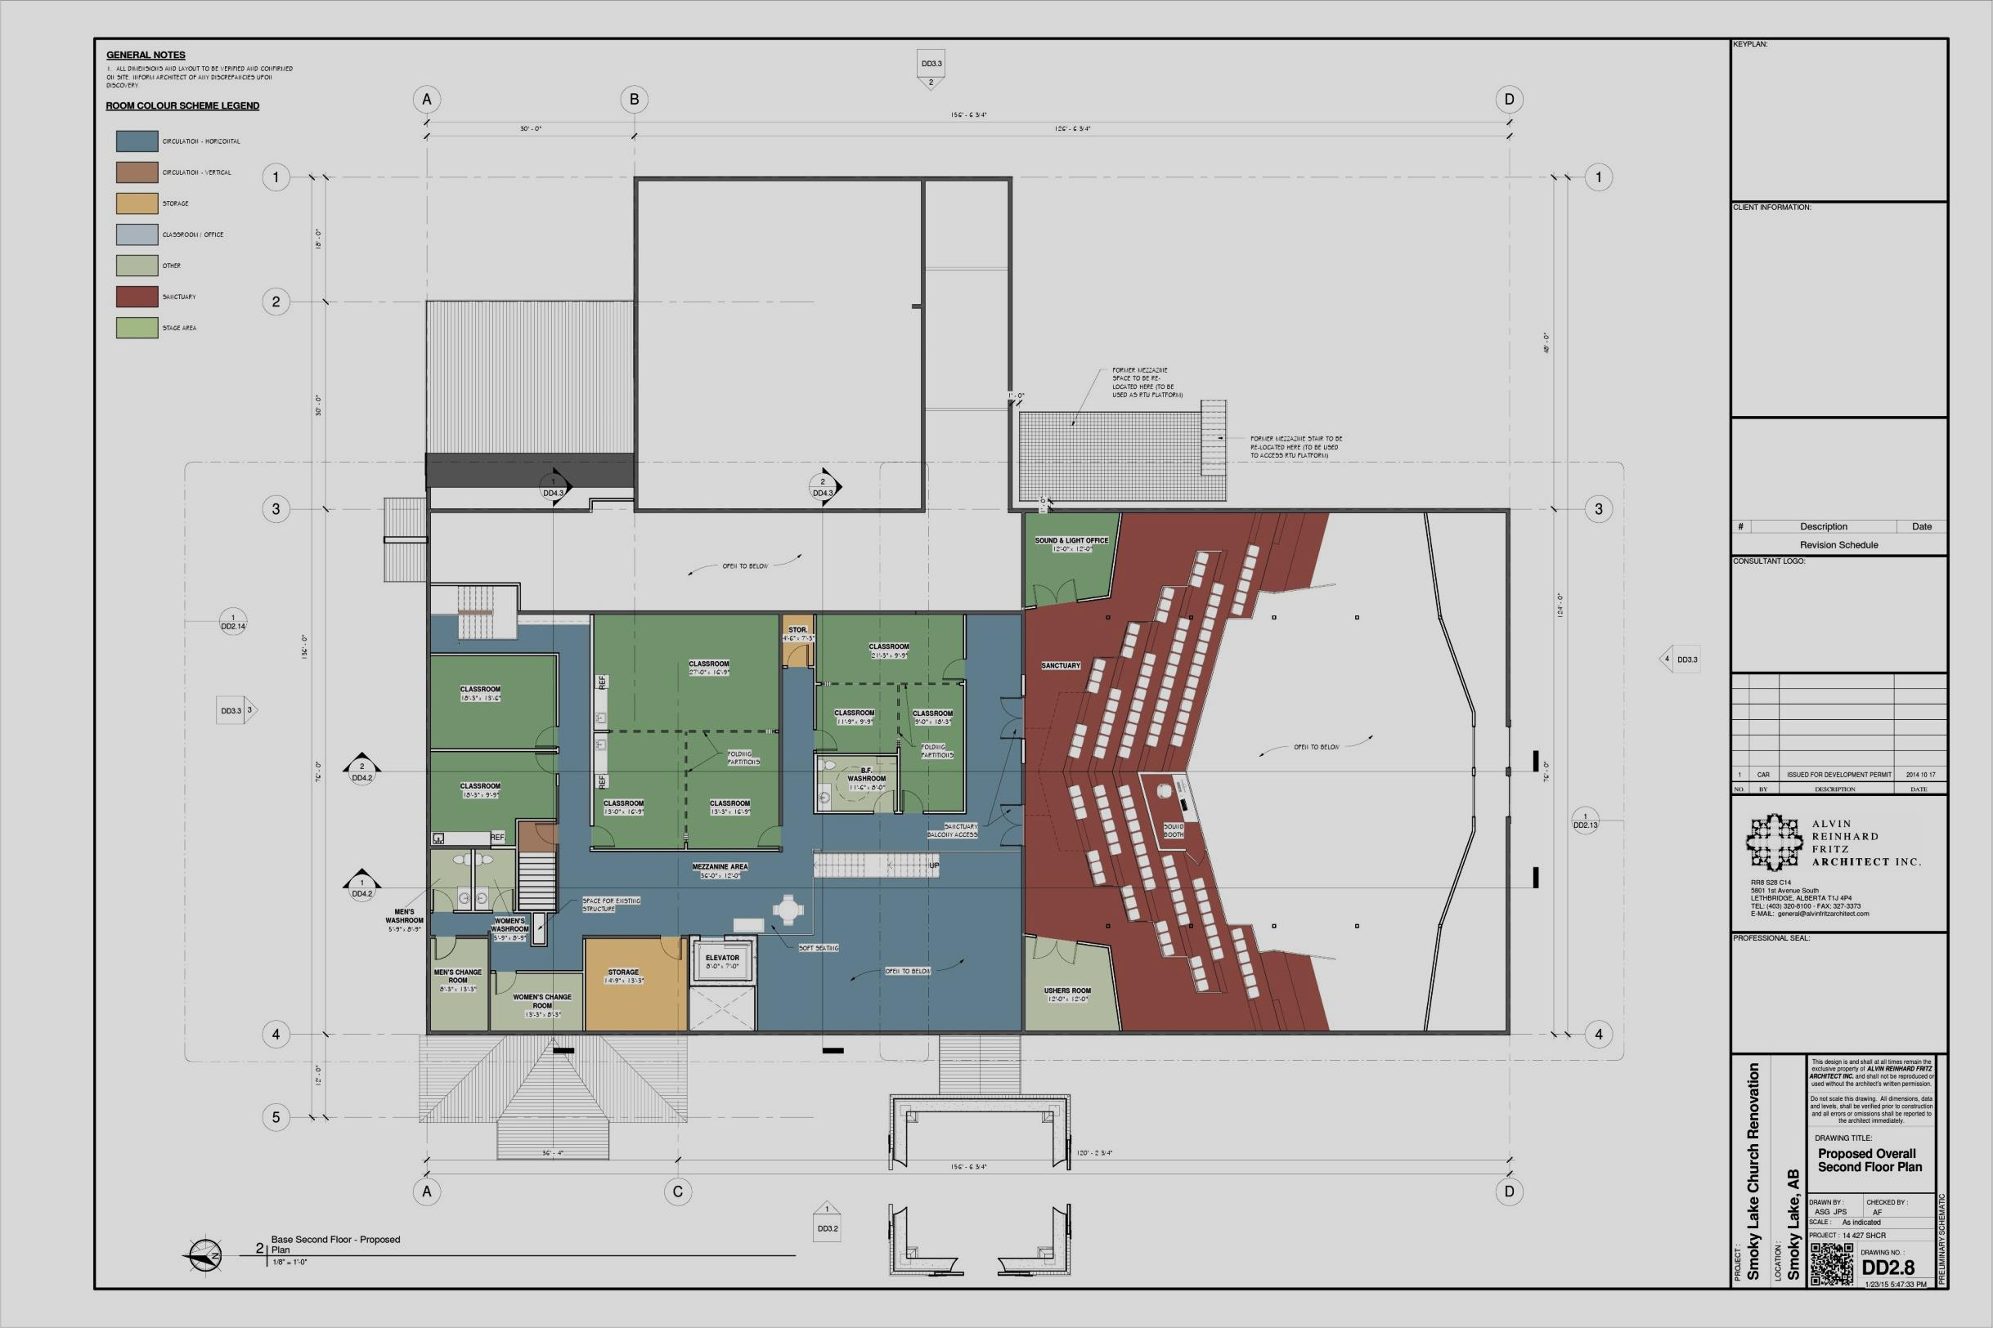
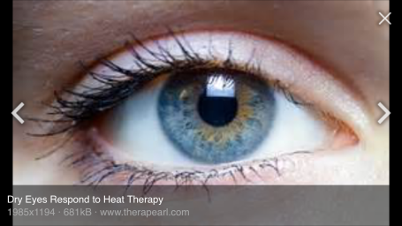
PROPOSED SECOND FLOOR PLAN
(COLOURED)
AF 14 427 SHCR
Smoky Lake, Alberta

Slide 6
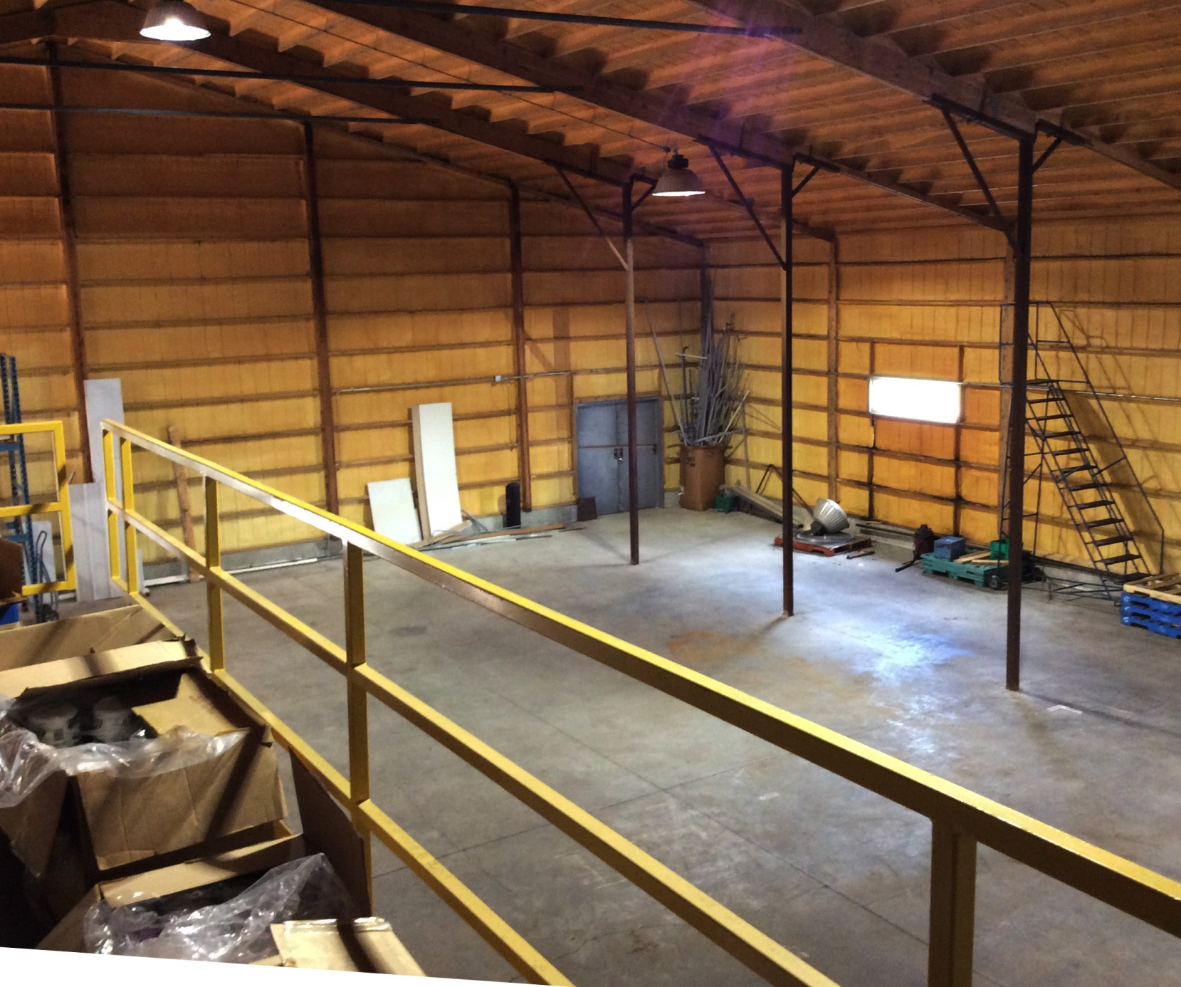
EXISTING WAREHOUSE INTERIOR
AF 14 427 SHCR
Smoky Lake, Alberta

Slide 7
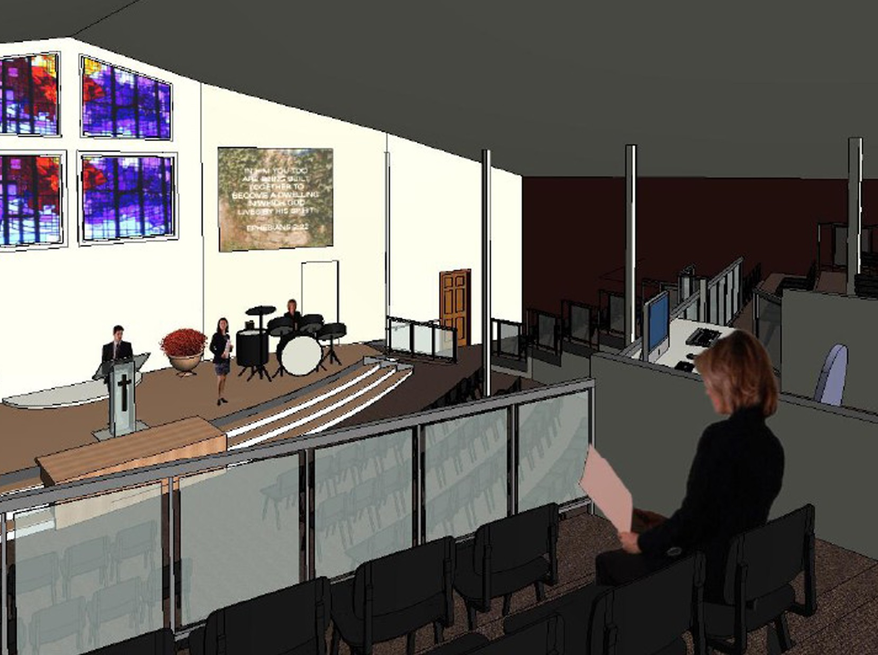
PROPOSED SANCTUARY INTERIOR
AF 14 427 SHCR
Smoky Lake, Alberta

Slide 8
PROPOSED SECOND FLOOR PLAN
(COLOURED)
AF 14 427 SHCR
Smoky Lake, Alberta

Slide 9
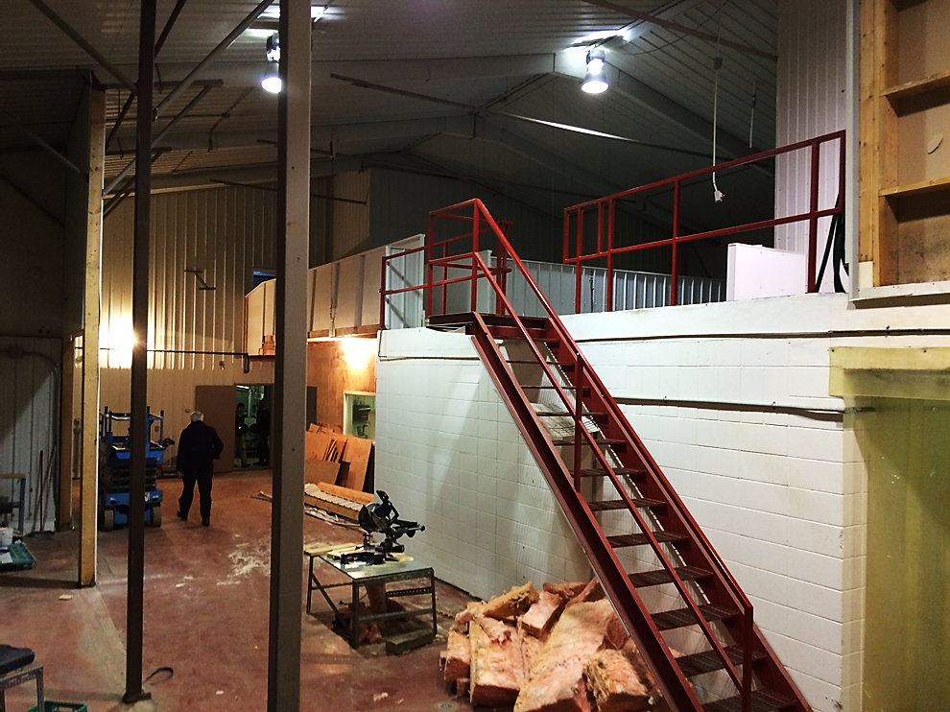
EXISTING WAREHOUSE INTERIOR
AF 14 427 SHCR
Smoky Lake, Alberta

Slide 10
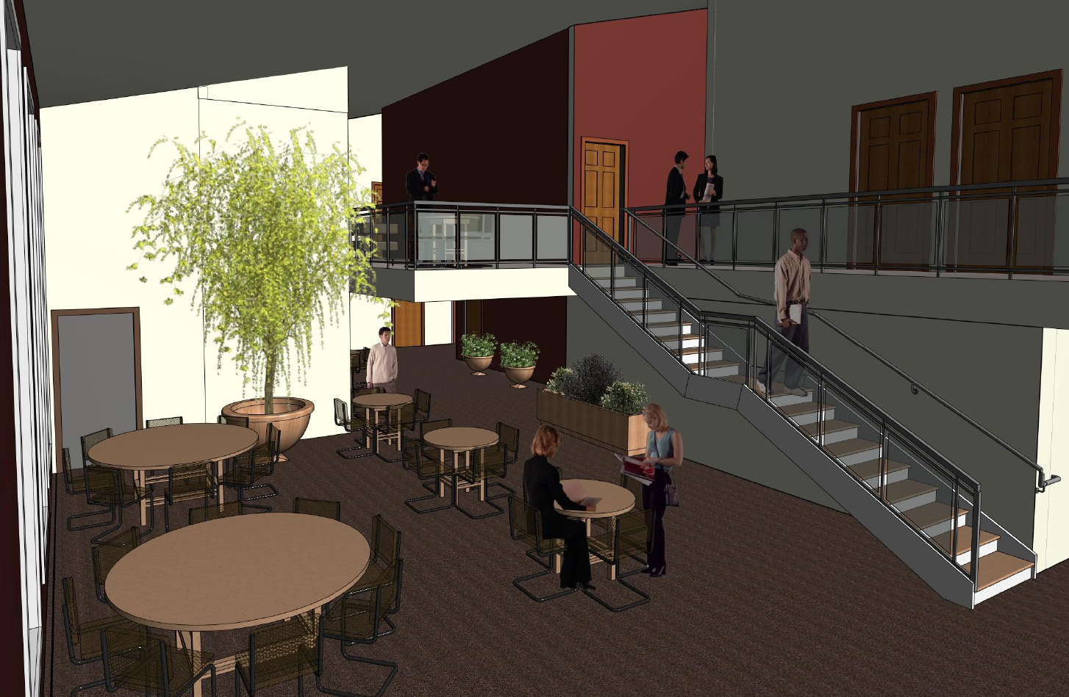
PROPOSED CAFE INTERIOR
AF 14 427 SHCR
Smoky Lake, Alberta

Slide 11
PROPOSED SECOND FLOOR PLAN
(COLOURED)
AF 14 427 SHCR
Smoky Lake, Alberta

Slide 12
EXISTING 3D VIEWS
AF 14 427 SHCR
Smoky Lake, Alberta

Slide 13
PROPOSED 3D VIEWS
AF 14 427 SHCR
Smoky Lake, Alberta

Slide 14
EXTERIOR 1
AF 14 427 SHCR
Smoky Lake, Alberta

Slide 15
CONCEPTUAL BUILDING ON SITE
AF 14 427 SHCR
Smoky Lake, Alberta

